Slide 1
Operational Resilience Lessons – an ATCO’s view
15 SEPTEMBER 2022
SOFIA, BULGARIA

Slide 2
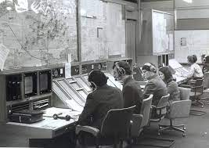
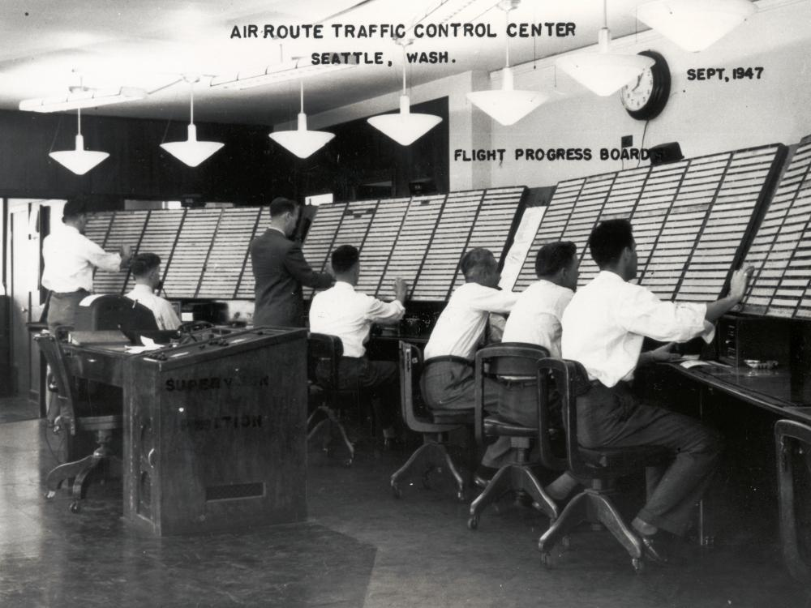
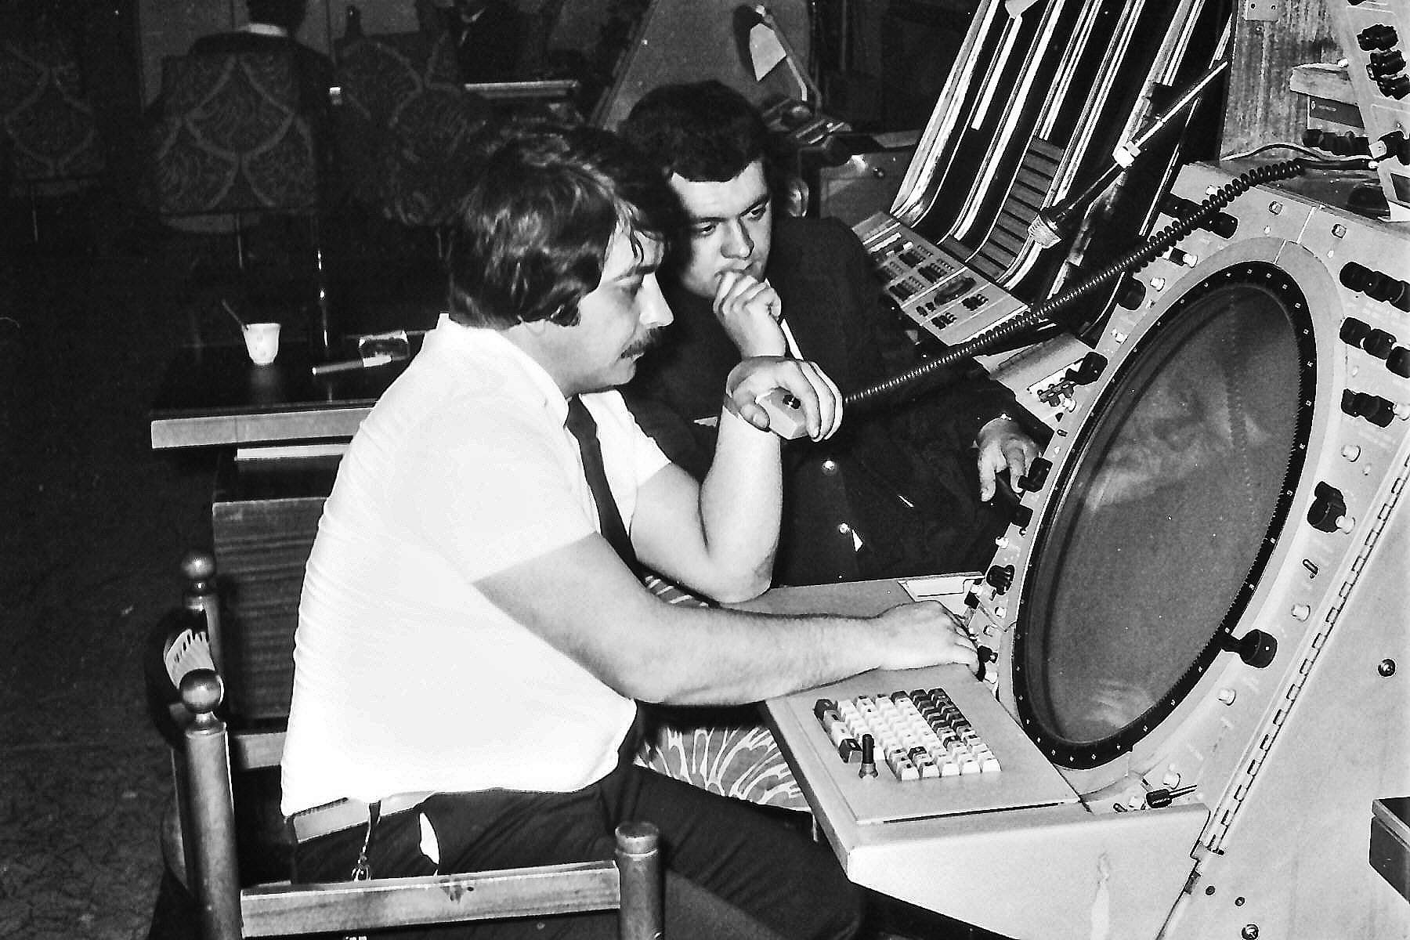
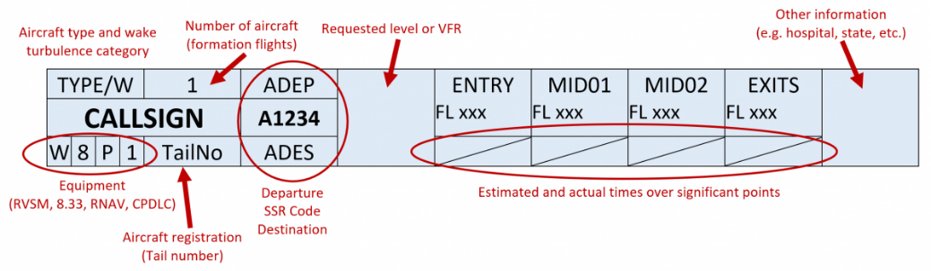
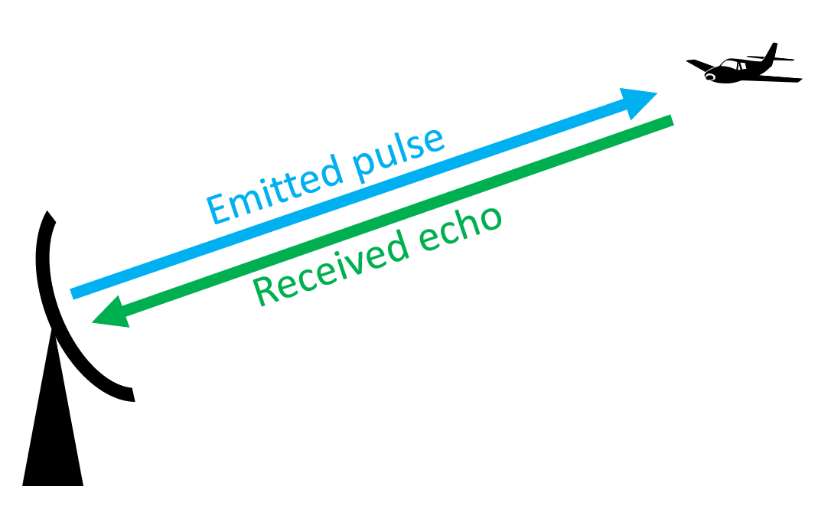
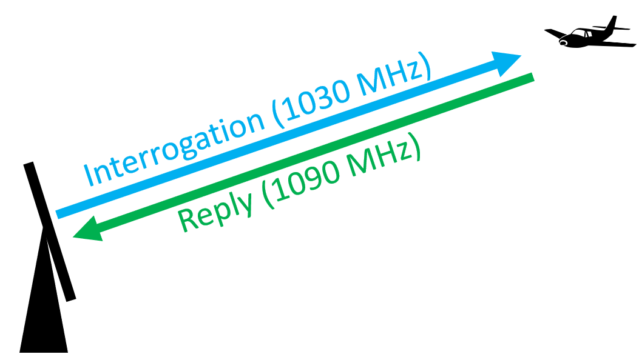
SETTING THE SCENE

Slide 3
THE BALANCE IN THE SYSTEM
Traffic
ATCOs
Tech
Safety

Slide 4
THE BALANCE IN THE SYSTEM
Traffic
ATCOs
Tech
Safety

Slide 5


RESILIENCE
In the context of ATM, Resilience is the intrinsic ability of a system to adjust its functioning prior to, during, or following changes and disturbances, so that it can sustain required operations under both expected and unexpected conditions.
A White Paper on Resilience Engineering for ATM, 2009
Resilience2050 was a European FP7 collaborative research project (2012)
Link: The Project – Resilience 2050

Slide 6
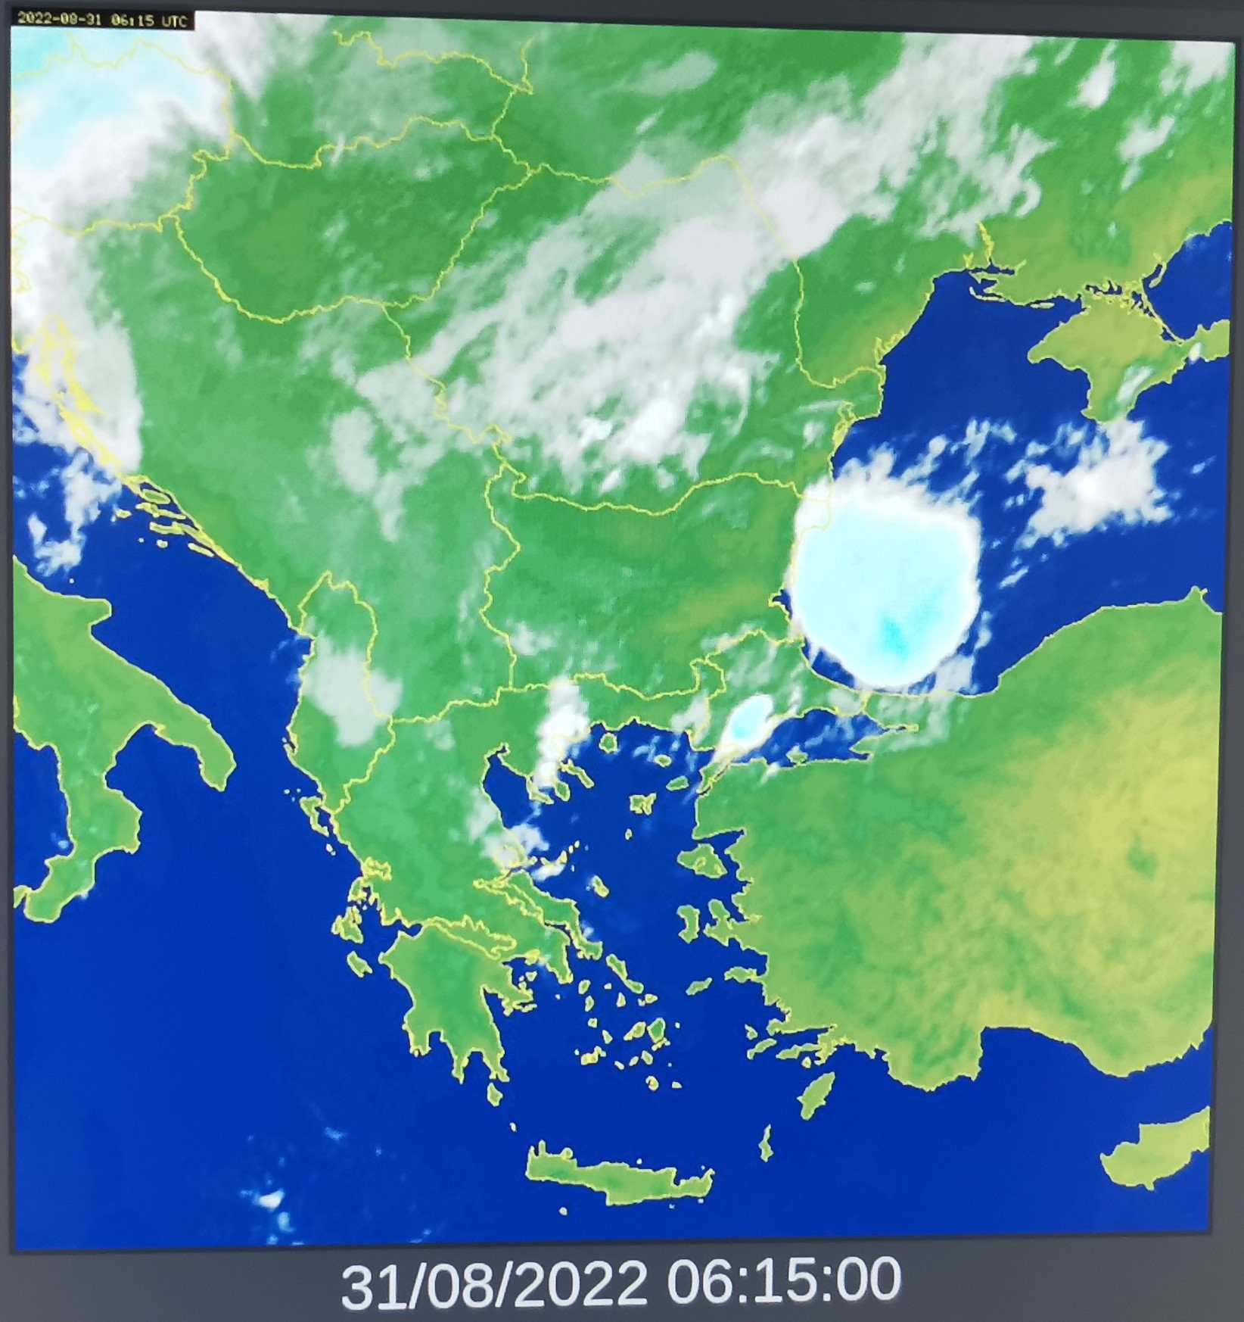
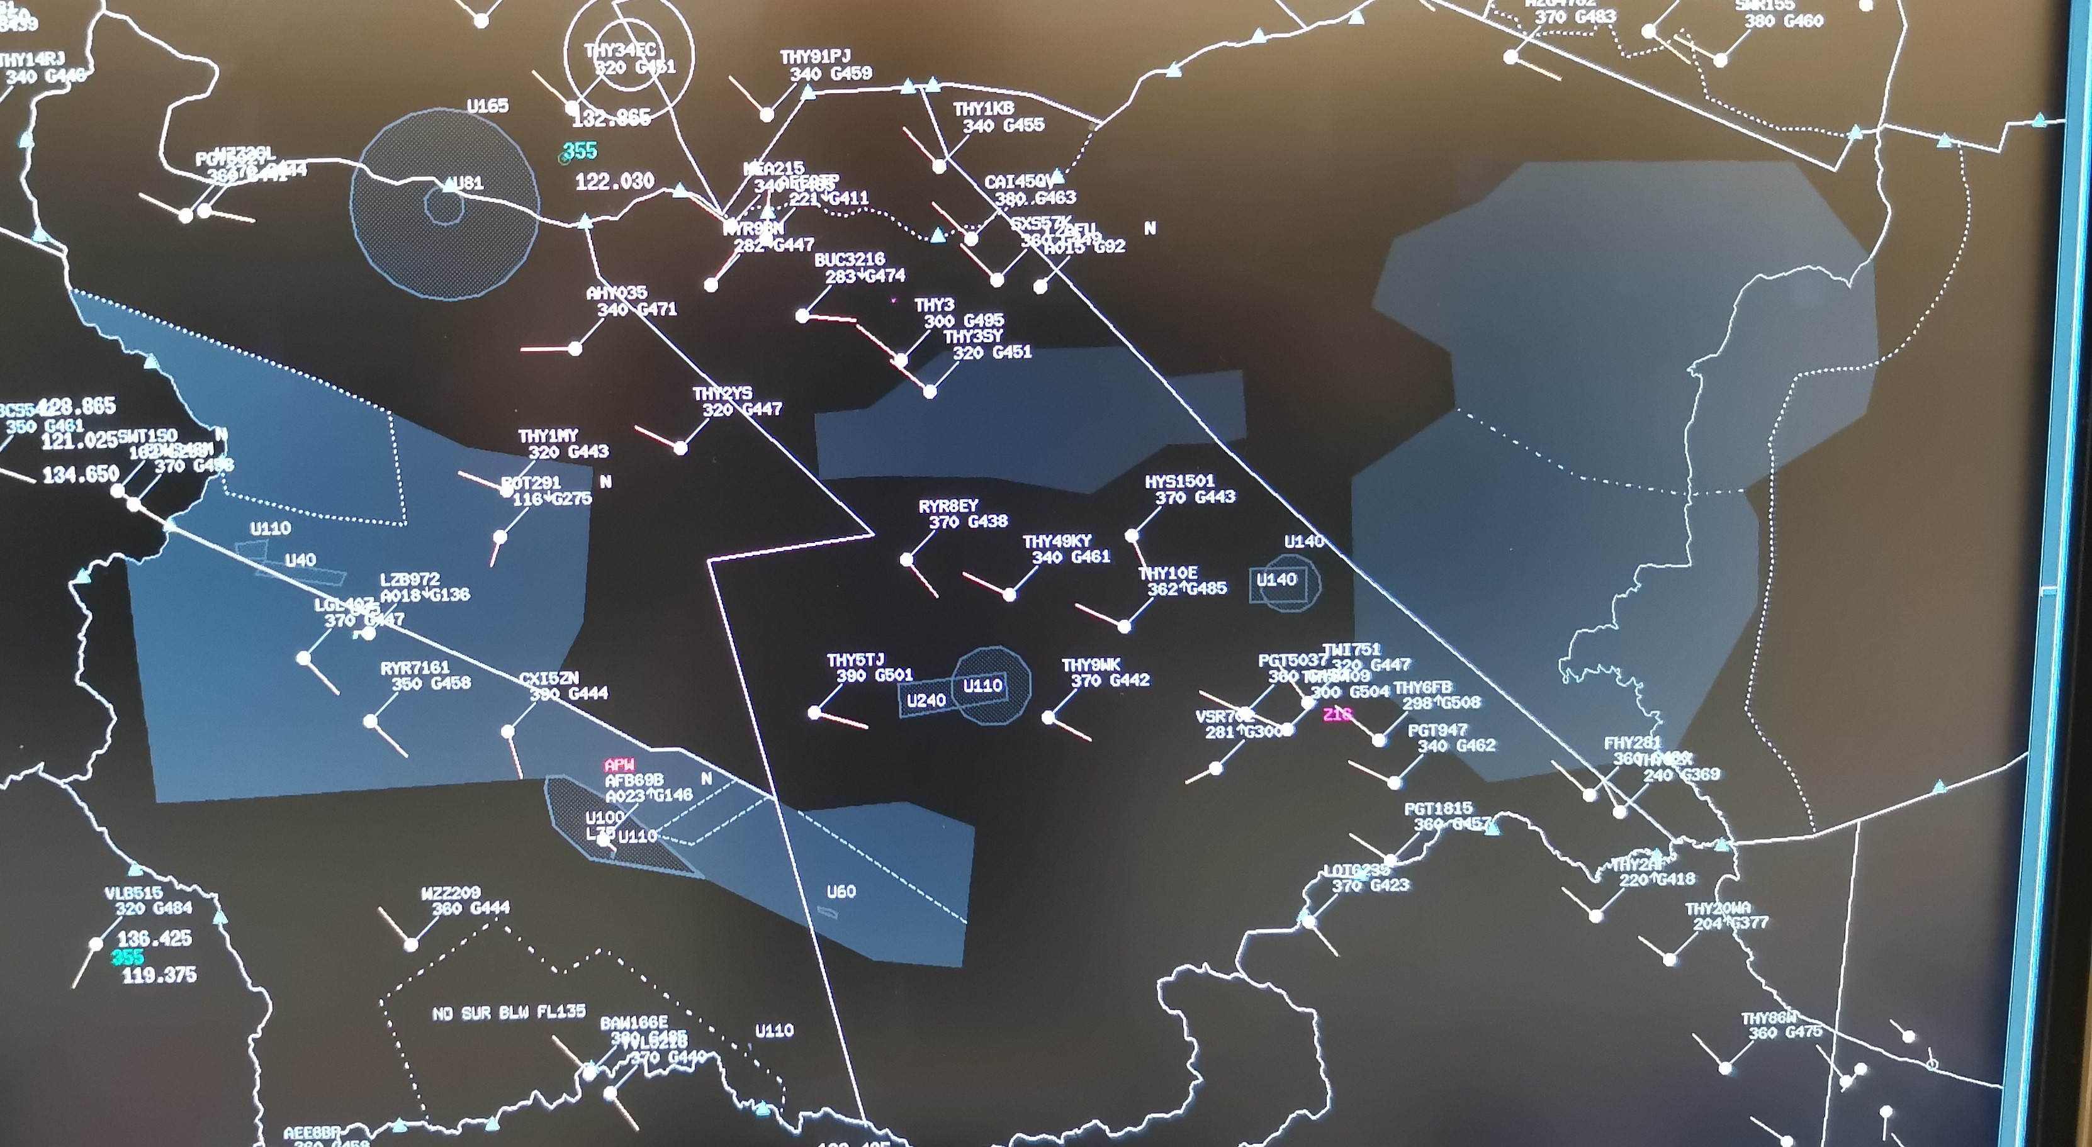
TRAFFIC VOLATILITY
Volatility due weather
Geopolitical volatility

Slide 7
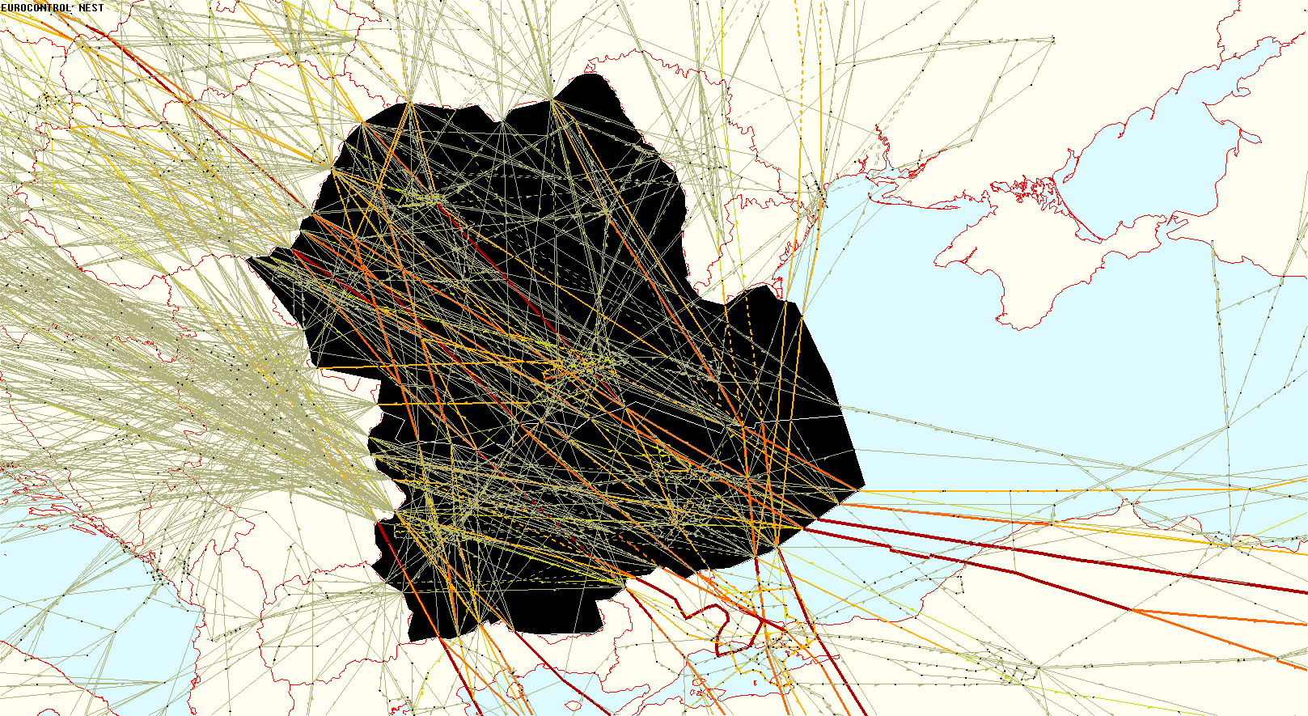
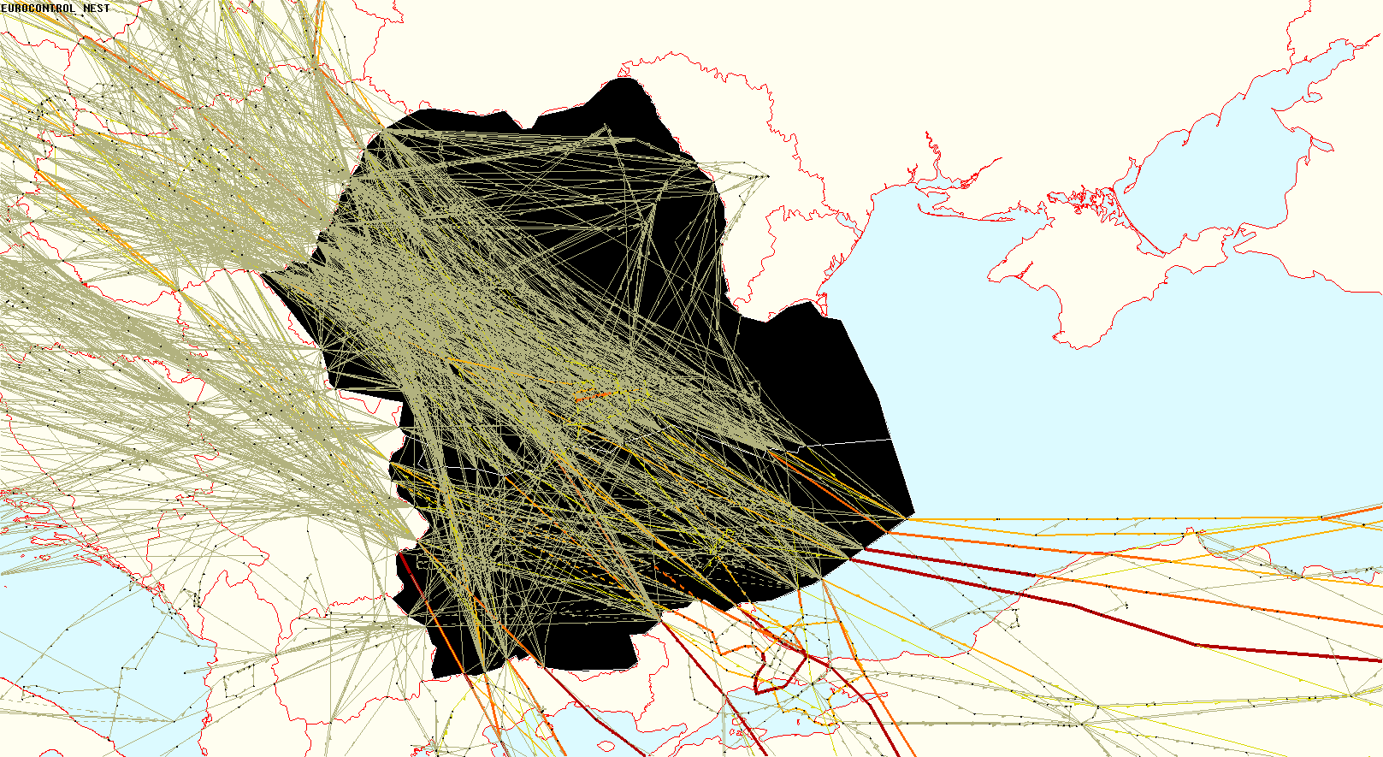
DISRUPTING FACTORS
2019
2022

Slide 8
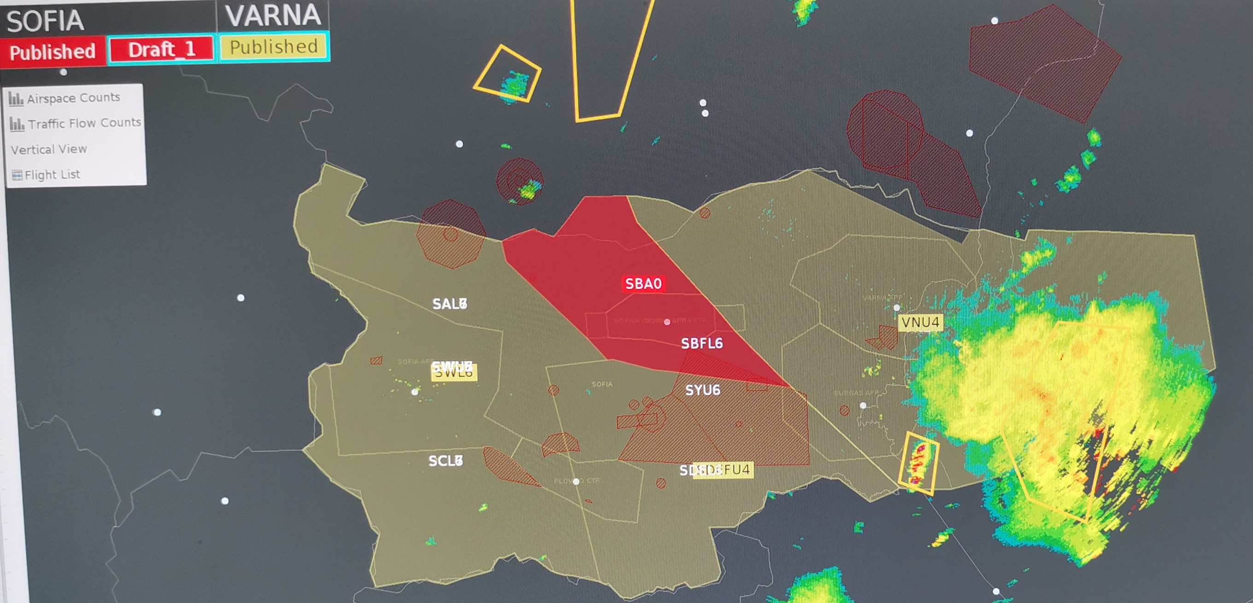
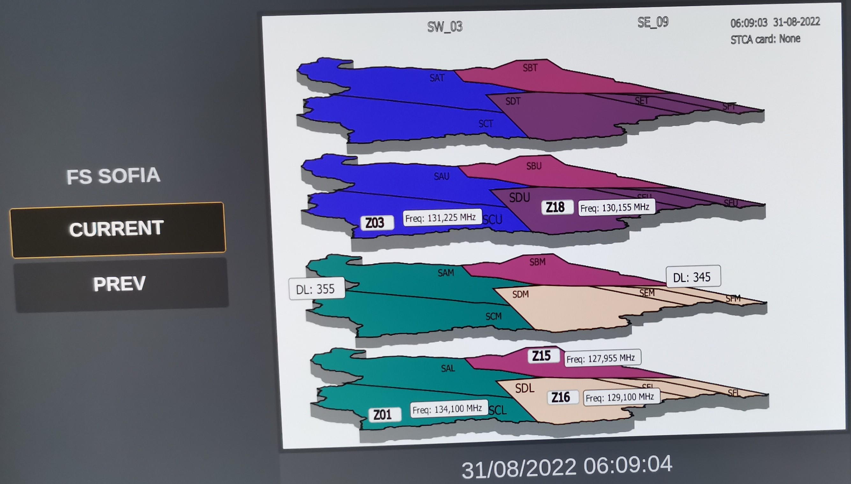
TECHNOLOGY
Technological solutions:
Automated ATM systems with improved ATCO tools, connectivity and interoperability
Stripless system (digital interaction)
Traffic Complexity Assessment Tool (tCAT)
CPDLC
Airspace management

Slide 9
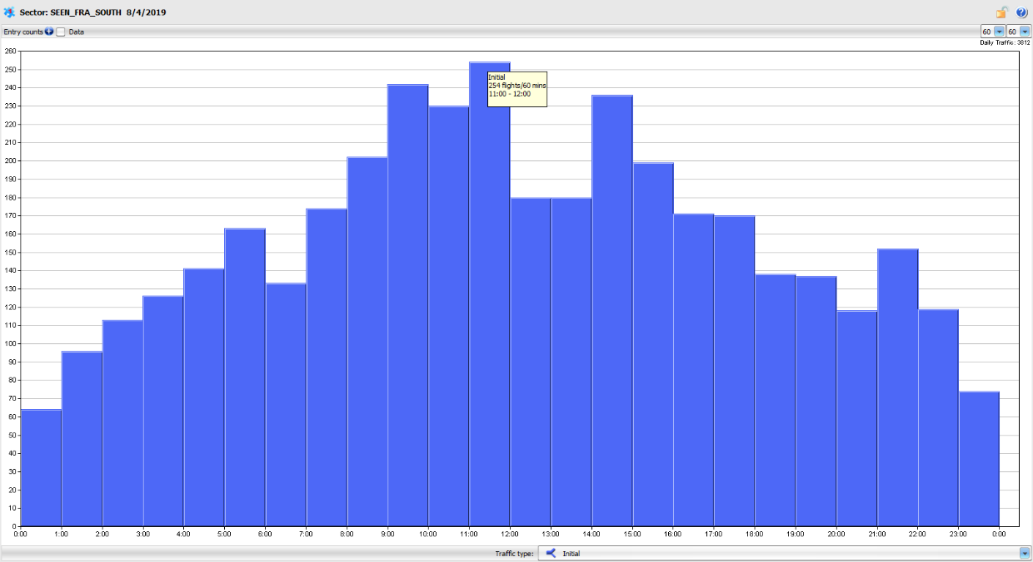

STRATEGIES
Efficient use of ATCOs:
Flexibility of available shifts - ATCOs move with the variations of the traffic load
Fine balance: demanding shift work vs motivation and fatigue
Sophisticated ATCO rostering tools
Cross-training

Slide 10


operational resilience must go hand in hand with the financial resilience
Financial resilience can be defined as “the ability to cope financially when faced with a sudden fall in income or unavoidable rise in expenditure”
UK Office for National Statistics
This requires an ability to respond to demand as flexibly as possible, while maintaining the financial stability of the company.

Slide 11
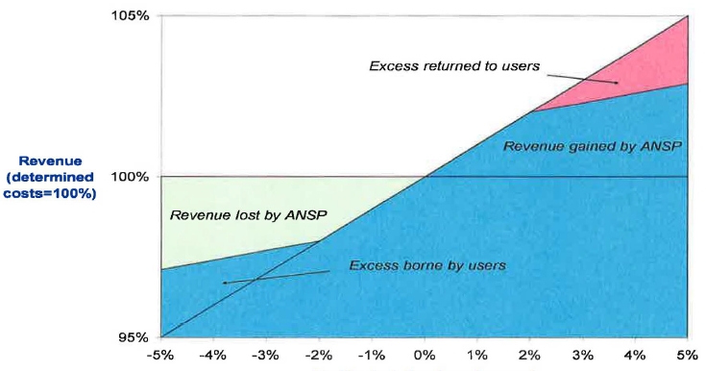
Adapting to different traffic levels through improving cost base elasticity
Performance and charging scheme assumes that ANSPs can cope with the differences in traffic compared to the forecasts of about 10%.
Keep the ability to adjust costs during periods of low traffic while keeping sufficient buffer for copying with higher traffic growth than originally foreseen. This can be achieved through improving “cost base elasticity”

Slide 12
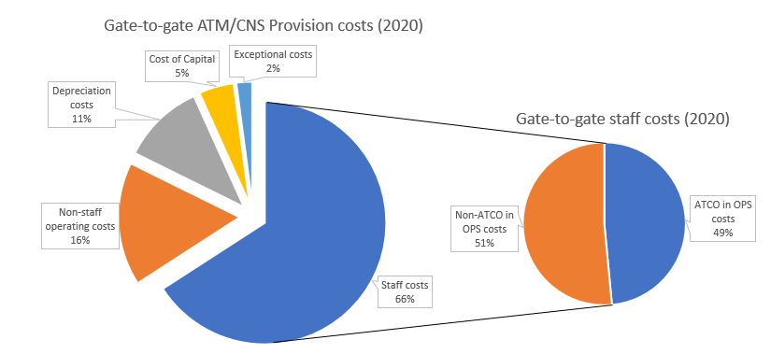
Looking at ANSP cost structure suggests to look at staff costs
ACE 2020 Benchmarking, PRU
ATCO costs in ANSP industry is anything but not variable. In theory, yes. The costs could be reduced through redundancies or flexible contracts but where is the cost-benefit?
Re-employing staff and re-training is expensive and time-consuming

Slide 13

So, can ANSP staff costs be made more elastic?
Negotiate flexibility
Analyse rostering
Re-deploy for added value
Undertake detailed manpower planning
Check blog on exploring cost base elasticity for ANSPs

Slide 14

Cutting capex programmes would be short-sighted
We need to come out of a crisis stronger, more resilient and better prepared for similar future shocks.
A structured review of the investment programmes needs to look at reprioritizing and potentially streamlining investments to make sure that sufficient resources are available where they are really needed.
Check blog on “Is it time to ‘invest’ or ‘divest’”?

Slide 15

Framework for assessing the investment programme during crises
Assessment of the situation before the crisis:
What were the most constraining issues negatively affecting our performance before the crisis?
Are these issues still valid or have they been completely eliminated by the current situation?
What will happen if the recovery is more optimistic or pessimistic than the current scenarios?
Which projects are absolute musts in terms of solving these issues?

Slide 16
Review the programme elements against the following criteria
Will the investment help my staff to be more flexible?
Is the investment aligned with the EAAS vision?
Is the investment needed for sustainability?
Is the investment needed for compliance with Regulation?
Is the investment still needed for performance improvements (ie to support increased safety, capacity, efficiency etc) in light of the current situation?
What will happen to our performance if the project is delayed/cancelled and the traffic recovers?
Which other projects will be impacted by delaying/cancelling the project and how?
Is the technology aligned with the future vision and will it contribute to improving resilience, scalability and sustainability? What other alternatives do we have?
Is the technology still financially viable?
Do we need additional investments to improve our resilience against future shocks?

Slide 17
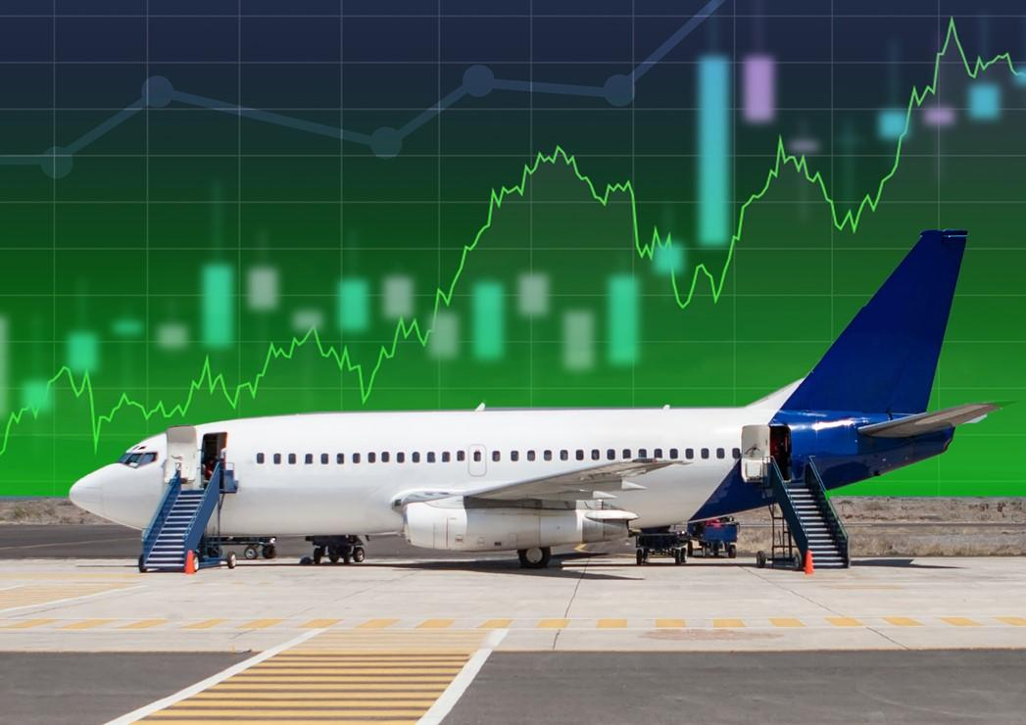
The crises should be seen as an opportunity
We should not repeat the mistakes of the past
Do not think short-term, what will happen if the development is much more optimistic or pessimistic?
Keep human factor at the centre of the strategy to become more resilient

Slide 18

CONCLUSION
Performance conditions in ATM are always challenging
ATCOs are responsible for the lives of thousands of people
The margin of error is zero
Safety buffer
Humans are the very centre of the resilient ATM system
“…well-coordinated operations and actions of human operators are essential to maintain resilience in the complex ATM system.”
Tech
Traffic
ATCOs
Safety

Slide 19

Thank you for your attention!
Questions?

